Slide 1

Peaceful Paradise
Project presentation

Slide 2


The Idea
Our logo
Hotel website
Reservation algorithm
Reception application

Slide 3

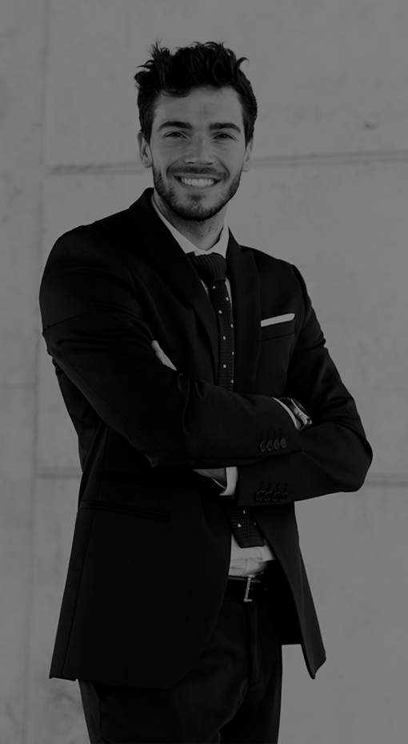
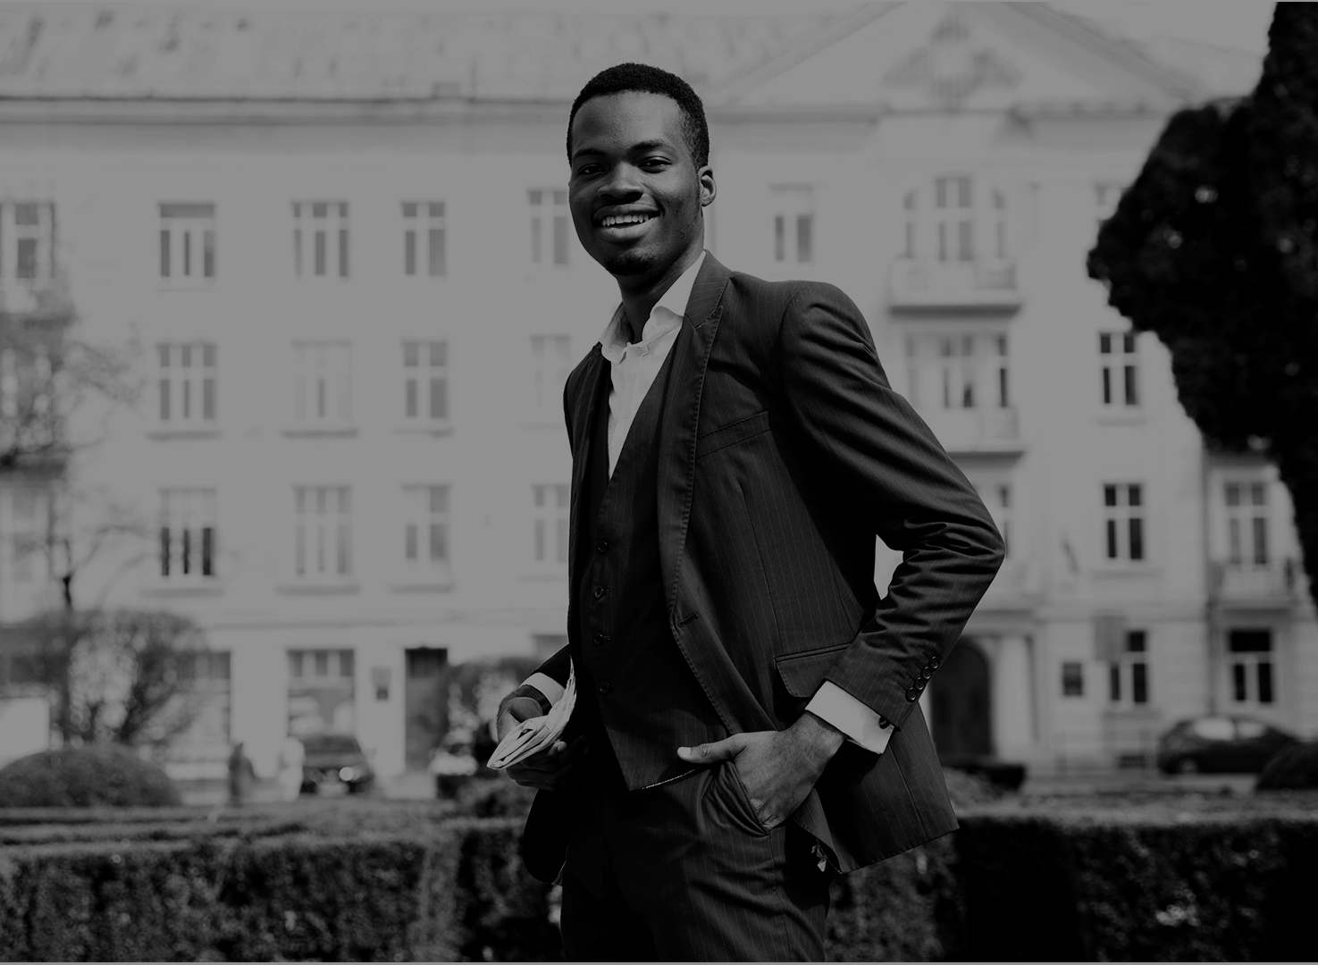
Our Team
Gábor Roncz
Reservation System
API Requests
Dávid Kálmán
Kornél Vass
Design
Sign-in, Email
Reception App
Database

Slide 4
Booking Process
Step 1
Step 2
Step 3
Step 4
Step 5
Search a free room by your needs
Select the type of the room
Pick a service type
Provide your personal data
Finalize the reservation

Slide 5




Our discount system
Gold
Platinum
Diamond
3 reservations
5% discount
6 reservations
10% discount
9 reservations
15% discount

Slide 6

Login
Registration
Email or username
Password
Forgot password
Name
Email
Password
Confirmation

Slide 7

Email sending
At
Registration
Password recovery
Changing email address
Confirming a reservation
Contacting us

Slide 8

Check-in
Check-out
Select a client
Validate their data
Arrange payment
Select a guest
Review their check-out date
Check their consumptions
Discuss remaining costs

Slide 9

Advertising and Promotion
Consumptions
Inspect logs
Check messages
Assign elements to different reservations
Create new items
User logs
Reservation logs
Respond to reports
Read ratings

Slide 10

Thank you for your time!
Made by:
Dávid Kálmán
Gábor Roncz
Kornél Vass

